Slide 1
Modeling Data Formats Using DFDL
IBM Integration Bus v9
Steve Hanson
Architect, IBM DFDL
Co-chair, OGF DFDL WG

Slide 2
Please Note
IBM’s statements regarding its plans, directions, and intent are subject to change or withdrawal without notice at IBM’s sole discretion.
Information regarding potential future products is intended to outline our general product direction and it should not be relied on in making a purchasing decision.
The information mentioned regarding potential future products is not a commitment, promise, or legal obligation to deliver any material, code or functionality. Information about potential future products may not be incorporated into any contract. The development, release, and timing of any future features or functionality described for our products remains at our sole discretion.
Performance is based on measurements and projections using standard IBM benchmarks in a controlled environment. The actual throughput or performance that any user will experience will vary depending upon many factors, including considerations such as the amount of multiprogramming in the user’s job stream, the I/O configuration, the storage configuration, and the workload processed. Therefore, no assurance can be given that an individual user will achieve results similar to those stated here.

Slide 3
Agenda
DFDL in More Depth
Modeling Data using DFDL
Industry Format Examples
Questions

Slide 4

Data Format Description Language (DFDL)
A new open standard
From the Open Grid Forum (OGF)
http://www.ogf.org/
Version 1.0
‘Proposed Recommendation’ status
A way of describing data…
It is NOT a data format itself!
A powerful modeling language …
Text, binary and bit
Commercial record-oriented
Scientific and numeric
Modern and legacy
Industry standards
While allowing high performance …
You choose the right data format for the job
Leverage XML Schema technology
Uses W3C XML Schema 1.0 subset & type system to describe the logical structure of the data
Uses XSDL annotations to describe the physical representation of the data
The result is a DFDL schema
Both read and write
Parse and serialize data in described format from same DFDL schema
Keep simple cases simple
Annotations are human readable
Intelligent parsing
Automatically resolve choice and optionality
Validation of data when parsing and serializing

Slide 5
IBM DFDL
Designed as an embeddable component
First shipped in 2011 (IBM WMB V8)
Now at level v1.1
DFDL processor
High performance Parser and Serializer
Java and C
Streaming, on-demand, speculative
Pre-compiles DFDL schema
Parser emits SAX-like events
Tooling for creating DFDL models
DFDL Schema editor eclipse plugins
Guided authoring wizards
COBOL & C importer wizards
Debug model using real data from within tooling
IBM DFDL v1.1 implements majority of the OGF DFDL 1.0 specification
Some more advanced features of DFDL are not yet available
Will be added in future DFDL deliverables until 100% achieved
v1.1 adds lengthKind ‘pattern’ (regex), fn:exists() and fn:empty()
intval=5;fltval=-7.1E8
<xs:schema …>
<xs:annotation>
<xs:appinfo …>
</xs:appinfo>
</xs:annotation>
...
</xs:schema>
IBM DFDL
Processor
<Document>
<Element name=“myNumbers”/>
<Element name=“myInt” …/>
<Element name=“myFloat” …/>
</Element>
</Document>

Slide 6
DFDL Subset of XML Schema
Element
type
*
*
model group
Complex Type
Simple Type
namespaces
import & include
local & global
minOccurs & maxOccurs
default, fixed & nillable
Sequence
Choice
DFDL annotations are placed on yellow objects only, and on the schema itself

Slide 7
Notes – DFDL Subset of XML Schema
The W3C XML Schema standard was obviously invented to model XML documents, but it turns out to be a good model for the logical structure of all kinds of data. Rather than invent a new logical model, DFDL decided to use XML Schema for its logical model. Not only is this a great example of reuse, it provides great interoperability with XML. As well as describing a custom text or binary format, a DFDL schema also describes the equivalent XML rendering of that data, for free.
DFDL doesn’t use all of XML Schema though, it uses a subset – just enough to allow general text and binary data to be modeled. So a DFDL schema contains Simple Types, Complex Types, Elements, Sequence Groups and Choice Groups, but it does not contain Attributes, Wildcards, All Groups or Substitution Groups, for example.
DFDL annotations appear on Simple Types, Elements, Sequence Groups and Choice Groups, and on the Schema itself.
Other features of XML Schema that are used by DFDL are namespaces (so schemas do not clash with other schemas), ‘include’ and ‘import’ (for creating modular schemas), local and global objects (allowing reuse of Elements and Groups), ‘minOccurs’ and ‘maxOccurs’ (to model arrays and optional Elements), ‘default’ and ‘fixed’ (to model Element default values) and ‘nillable’ (to model out-of-band Element values).
Also many of XML Schema’s built-in simple types are not needed for general text or binary data, so only a subset of these is used as shown on the next page.

Slide 8
Notes - DFDL Subset of Simple Types
DFDL type
anySimpleType
string
QName
NOTATION
float
double
decimal
boolean
base64Binary
hexBinary
anyURI
normalizedString
integer
token
long
nonPositiveInteger
nonNegativeInteger
language
Name
NMTOKEN
int
negativeInteger
positiveInteger
unsignedLong
NCName
NMTOKENS
short
unsignedInt
ID
IDREF
ENTITY
byte
unsignedShort
IDREFS
ENTITIES
unsignedByte
date
time
dateTime
gYear
gYearMonth
gMonth
gMonthDay
gDay
duration

Slide 9
DFDL Annotations - Basic
Annotation | Used on Component | Purpose
dfdl:element | xs:element xs:element reference | Contains the DFDL properties of an xs:element or xs:element reference
dfdl:choice | xs:choice | Contains the DFDL properties of an xs:choice.
dfdl:sequence | xs:sequence | Contains the DFDL properties of an xs:sequence.
dfdl:group | xs:group reference | Contains the DFDL properties of an xs:group reference to a group definition containing an xs:sequence or xs:choice.
dfdl:simpleType | xs:simpleType | Contains the DFDL properties of an xs:simpleType
dfdl:format | xs:schema dfdl:defineFormat | Contains a set of DFDL properties that can be used by multiple DFDL schema components. When used directly on xs:schema, the property values act as defaults for all components in the DFDL schema.
dfdl:defineFormat | xs:schema | Defines a reusable data format by associating a name with a set of DFDL properties contained within a child dfdl:format annotation. The name can be referenced from DFDL annotations on multiple DFDL schema components, using dfdl:ref.

Slide 10
DFDL Annotations - Advanced
Annotation | Used on Component | Purpose
dfdl:assert | xs:element, xs:choice xs:sequence, xs:group | Defines a test to be used to ensure the data are well formed. Used only when parsing.
dfdl:discriminator | xs:element, xs:choice xs:sequence, xs:group | Defines a test to be used when resolving a point of uncertainty such as choice branches or optional elements. Used only when parsing.
dfdl:escapeScheme | dfdl:defineEscapeScheme | Defines a scheme by which escape characters can be specified. This is for use with delimited text formats.
dfdl:defineEscapeScheme | xs:schema | Defines a named, reusable escape scheme. The name can be referenced from DFDL annotations on multiple DFDL schema components.
dfdl:defineVariable | xs:schema | Defines a variable and creates an instance of it. A variable can be used to communicate a parameter from one part of processing to another part.
dfdl:newVariableInstance | xs:element, xs:choice xs:sequence, xs:group | Creates a new instance of a previously defined variable.
dfdl:setVariable | xs:element, xs:choice xs:sequence, xs:group | Sets the value of a variable instance.

Slide 11
DFDL Properties
DFDL properties describe the physical representation of the objects in a DFDL schema
There are many DFDL properties, the most important being:
Element & SimpleType: dfdl:representation, dfdl:lengthKind
Element only: dfdl:occursCountKind
Sequence: dfdl:sequenceKind, dfdl:separator
Choice: dfdl:choiceKind
All: dfdl:initiator, dfdl:terminator, dfdl:encoding, dfdl:alignment
DFDL properties do not have built-in defaults!
If an object needs a property, a value must be supplied
A property may be set:
On an object directly
On the schema’s dfdl:format annotation, it acts as a default for all objects in the schema
On a named dfdl:defineFormat annotation, and referenced from an object using the special dfdl:ref property
An Element may inherit properties from its Simple Type
An Element/Group ref may inherit properties from its global Element/Group

Slide 12
Example - DFDL Properties
a26;b34@;c67;d90%;
Default field terminator is “;” but can vary
<xs:schema>
<xs:annotation> <xs:appinfo source=“http://www.ogf.org/dfdl/” > <dfdl:format terminator=“;” encoding=“ASCII” … /> </xs:appinfo>
</xs:annotation>
<xs:complexType name=“fmt1”>
<xs:sequence > <xs:element name=”A” type=”xs:string” /> <xs:element name=”B” type=”xs:string” /> <xs:element name=”C” type=”xs:string” /> <xs:element name=”D” type=”xs:string” /> </xs:sequence> </xs:complexType>
</xs:schema>
Terminator from schema’s dfdl:format
dfdl:terminator=“”
dfdl:terminator=“@;”
dfdl:terminator=“%;”
Terminator set on object

Slide 13
Notes – Example – DFDL Properties
Consider a simple delimited text structure consisting of 4 fields. Each field is delimited by a terminator, but the terminator is not the same for each field. The character “;” is the most common terminator but there are variations.
A DFDL schema can be set up so that DFDL properties that are common to multiple schema components need only be declared once, by using a dfdl:format annotation at the top level of the schema itself. These properties effectively act as defaults for all components in the schema. (Remember, there are no built-in DFDL property defaults in DFDL).
In the example, we set the dfdl:terminator and dfdl:encoding properties in this manner. They then apply to all the Elements and to the Sequence.
To complete the model, we set the dfdl:terminators of the Elements where the terminator is not the default one.
Note that in DFDL a Sequence also can have a terminator, so unless we do something the DFDL parser will expect to see an extra “;” at the end of the data. The solution is to set the dfdl:terminator of the Sequence to indicate that it has no terminator – this is indicated by using empty string as the value.
Be aware that setting a DFDL property on a Sequence or Choice does not affect its child Elements. The property only applies to the object on which it appears. For example, setting the dfdl:encoding on a Sequence says that any initiator, terminator or separator for that Sequence is in that encoding, but it implies nothing about the encoding of its children.

Slide 14
DFDL Points of Uncertainty
A DFDL parser is a recursive-descent parser with look-ahead used to resolve ‘points of uncertainty’:
A choice
An optional element
A variable array of elements
A DFDL parser must speculatively attempt to parse data until an object is either ‘known to exist’ or ‘known not to exist’
Until that applies, the occurrence of a processing error causes the parser to suppress the error, back track and make another attempt
The dfdl:discriminator annotation can be used to assert that an object is ‘known to exist’, which prevents incorrect back tracking
Initiators are also able to assert ‘known to exist’

Slide 15
Example - DFDL Points of Uncertainty
<xs:choice> <xs:element name=”Update” >
<xs:complexType>
<xs:sequence>
<xs:element name=”Type” type=“xs:int” dfdl:representation=“binary” ...> <xs:annotation><xs:appinfo source=“http://www.ogf.org/dfdl/” > <dfdl:discriminator test=“{. eq 1}” /> </xs:appinfo></xs:annotation>
</xs:element>
... </xs:sequence> </xs:complexType> </xs:element> <xs:element name=”Create” > <xs:complexType>
<xs:sequence>
<xs:element name=”Type” type=“xs:int” dfdl:representation=“binary” ...> <xs:annotation><xs:appinfo source=“http://www.ogf.org/dfdl/” > <dfdl:discriminator test=“{. eq 2}” /> </xs:appinfo></xs:annotation>
</xs:element>
... </xs:sequence> </xs:complexType> </xs:element> </xs:choice>
Discriminator resolves the choice
Initiators discriminate the choice

Slide 16
DFDL Expressions
DFDL provides an expression language that can be used at various places in a DFDL schema:
When a property value needs to be set dynamically from the contents of the data
In an assert or discriminator annotation
When setting the value or default value of a variable
The expression language is a subset of XPath 2.0, including variables, and with some extra DFDL-specific functions
Expressions are always enclosed by curly braces { }
<xs:complexType>
<xs:sequence dfdl:separator=“,” ... > <xs:element name=”count” type=”xs:nonNegativeInteger”
dfdl:representation=“text” dfdl:lengthKind=“delimited”
dfdl:textNumberPattern=“#0” ... /> <xs:element name=”value” type=”xs:string” maxOccurs=“unbounded”
dfdl:lengthKind=“delimited”
dfdl:occursCountKind=“expression”
dfdl:occursCount=“{../count}” ... /> </xs:sequence> </xs:complexType>

Slide 17
Notes- DFDL Expressions
The example on the previous slide shows the use of an expression to provide the count of the number of occurrences for an unbounded array element called ‘value’. The example shows the use of a relative path to refer to a ‘count’ element earlier in the data.
The example below uses a DFDL variable instead of a relative path. The end result is the same.
<xs:schema>
<xs:annotation><xs:appinfo source=“http://www.ogf.org/dfdl/” > <dfdl:defineVariable name=“countVar” type=“xs:int” defaultValue=“0” /> </xs:appinfo></xs:annotation>
<xs:complexType>
<xs:sequence dfdl:separator=“,” ... > <xs:element name=”count” type=”xs:nonNegativeInteger”
dfdl:representation=“text” dfdl:lengthKind=“delimited”
dfdl:textNumberPattern=“#0” ... >
<xs:annotation><xs:appinfo source=“http://www.ogf.org/dfdl/” > <dfdl:setVariable ref=“countVar” value=“{.} /> </xs:appinfo></xs:annotation>
</xs:element> <xs:element name=”value” type=”xs:string” maxOccurs=“unbounded”
dfdl:lengthKind=“delimited”
dfdl:occursCountKind=“expression”
dfdl:occursCount=“{$countVar}” ... /> </xs:sequence> </xs:complexType>
</xs:schema>
Create variable
Write variable
Read variable

Slide 18
Agenda
DFDL in More Depth
Modeling Data using DFDL
Industry Format Examples
Questions

Slide 19
Approaching Data Modeling
Data modeling is like programming
You can read up on the theory
You can learn how to use the editor
The hard part is knowing how to structure your model
Knowledge
“A tomato is a fruit”
Wisdom
“Don’t put a tomato
in a fruit salad”
X
Notes:
People think that data/message modeling is a black art.
Some kind of witchcraft is needed to model messages that only a few people in the world can master.
That’s not true of course, you just need some knowledge and a bit of wisdom.
*Gag*. Who understands the difference between knowledge and wisdom?
Knowledge is knowing that a tomato is a fruit (not a vegetable).
Wisdom is knowing that you don’t put a tomato in a fruit salad.
So knowledge is knowing the facts, wisdom is about how you use those facts.
With data/message modeling, knowledge is knowing the DFDL spec, …
…wisdom is about how to look at your data format and work out the correct DFDL schema to model it.
The next few slides try to teach you a bit of wisdom associated with data/message modeling with DFDL.
-----------
And yes a tomato is a fruit – check out http://en.wikipedia.org/wiki/Tomato.
US states having tomato as their state fruit or veg:
Arkansas: Both fruit & veg !
Ohio: Fruit
Tennessee: Fruit
New Jersey: Legislation stuck in committee!
-----------

Slide 20
Notes – Approaching Data Modeling
Data modeling using DFDL has a strong analogy with programming. Let’s say you want to learn a new programming language and write a program to solve a business problem. Take Java as an example. You buy a Java book and read up on the language theory. You get hold of a good Java editor and learn how to use it. But the hardest part is taking your business problem and working out how to structure the program that will solve it. Very often you will look at examples created by other programmers in order to get a head start.
With DFDL data modeling it’s the same. You can learn the theory about the modeling language and you can learn how to use an editor for that language. But the hardest part is looking at the actual data and working out how to go about creating the best model for it.
If you are lucky the problem is solved in whole or in part by already having a model of the data in one format or another (metadata). For DFDL, IBM provides importers to convert COBOL and C metadata into DFDL schemas.
The real fun starts when you have no model to reference. All you have is one or more examples of the data format. This most frequently occurs for formatted text messages, such as Comma Separated Values (CSV) messages. We’ll show how to analyze data formats in order to understand the structure and create the corresponding DFDL model.

Slide 21
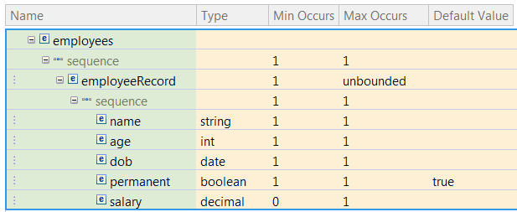
1) Understanding the Logical Structure
Identify complex structures
Provides your
Complex Types
Complex Elements
Identify simple items
Provides your
Simple Types
Simple Elements
Identify structure ordering
Provides your
Sequence Groups
Choice Groups
Identify structure and item cardinality
Provides your
Element minOccurs & maxOccurs
Identify nillable items and default values
Provides your
Element nillable & default
{N:Joe Bloggs,A:50,D:19620503,P:Y,S:40000}¶
{N:Fred Smith,A:30,D:19930225,P:Y,S:25000}¶
{N:Jane Plain,A:44,D:19780814,P:N}¶
How many different complex types?
2
Notes:
Go through the bullets above, then relate to the ‘employees’ message with 2 records.
Ask how many complex types – there are 2, the record and the overall message
Then show the 3rd record – is this a new complex type? No – it’s the same but with an optional field!

Slide 22
Notes – Understanding the Logical Structure
There are five stages to understanding the logical structure of your data
Identify the complex structures. These correspond to the Complex Types in the model. There will be an overall Complex Type for the entire data itself. If the data contains sub-structures, there will be a Complex Type per sub-structure. For example, each structure level in a COBOL copybook, or each different row in a CSV message, corresponds to an Element of Complex Type.
Identify the simple items. These occur within each Complex Type, and each has a logical data type. These correspond to simple Elements. For example each field in a COBOL copybook with a PIC clause, or each comma separated value in a CSV message, corresponds to an Element of Simple Type.
Identify the structure ordering rules. This determines whether the Group within a Complex Type is a Sequence or a Choice. In a Choice only one of the listed items can occur, examples being C unions and COBOL REDEFINES.
Identify complex structure and simple item cardinality. This provides the values for the minOccurs and maxOccurs logical properties of your Elements. Is an Element required (minOccurs != 0) or optional (minOccurs = 0)? Is an Element an array (maxOccurs > 1)? If so are there a fixed number of occurrences (minOccurs = maxOccurs) or a variable number of occurrences (minOccurs != maxOccurs)? Can the number of occurrences be unlimited (maxOccurs = unbounded)?
Identify nillable items and default values. Some Elements might need to carry a special out-of-band value, in which case they must be nillable. For example, a numeric field in a COBOL copybook might sometimes be set to SPACES which is not legal for a DFDL number. Some required Elements might be empty in the data, in which case a default value may be provided.
Can components be re-used? If any of the types are common, consider creating global Complex or Simple Types. If any of the Elements are common, consider creating global Elements.
.

Slide 23
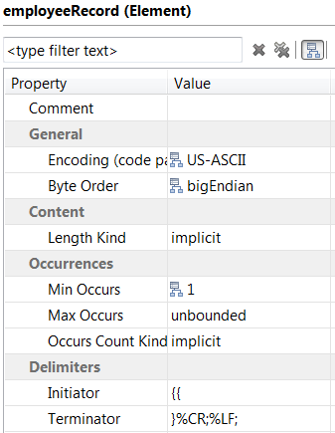
2) Configuring the DFDL Annotations
All Elements
Does it have delimiters ? initiator, terminator, encoding
How is length established ? lengthKind, lengthXxx
How many occurrences ? occursCountKind, occursXxx
Any alignment rules ? alignmentXxx, fillByte
Nillable? nilXxx
Discriminator needed ?
Simple Elements
Text ? representation, encoding, textXxx, escapeSchemeRef
Binary ? representation, byteOrder
Type is String ? textStringXxx
Type is Number ? textNumberXxx, binaryNumberXxx
Type is Boolean ? textBooleanXxx, binaryBooleanXxx
Type is Calendar ? calendarXxx, textCalendarXxx, binaryCalendarXxx
Split properties between Element and SimpleType ?
Sequence
Ordered or unordered ? sequenceKind
Separator ? separator, separatorPosition, separatorPolicy, encoding
Do all children have unique initiators ? initiatedContent
Choice
Are all branches the same length ? choiceKind
Do all branches have unique initiators ? initiatedContent
Do branches need discriminators ?

Slide 24
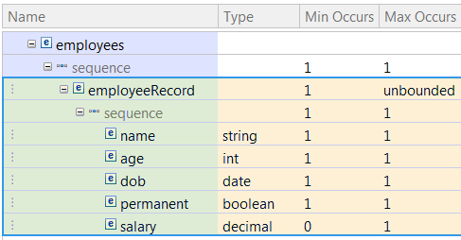
2) Configuring the DFDL Annotations
{N:Joe Bloggs,A:50,D:19620503,P:Y,S:40000}¶
{N:Fred Smith,A:30,D:19930225,P:Y,S:25000}¶
{N:Jane Plain,A:44,D:19780814,P:N}¶
Element “employees”
initiator=“”, terminator=“”, lengthKind=“implicit”, …
Element “employeeRecord”
initiator=“{”, terminator=“}%CR;%LF;”, encoding=“ASCII”, lengthKind=“implicit”, occursCountKind=“implicit”, …
Sequence for “employeeRecord”
sequenceKind=“ordered”, separator=“,”, separatorPosition=“infix”, separatorPolicy=“suppressedAtEnd”, …
Element “salary”
initiator=“S:”, terminator=“”, encoding=“ASCII”, lengthKind=“delimited”, representation=“text”, textNumberRep=“standard”, textNumberPattern=“#0.##”, occursCountKind=“implicit”, …
Element “permanent”
initiator=“P:”, terminator=“”, encoding=“ASCII”, lengthKind=“delimited”, representation=“text”, textBooleanTrueRep=“Y”, textBooleanFalseRep=“N”, …

Slide 25
Notes – Configuring the DFDL Annotations
Once the logical structure of your data is established, the DFDL annotations can be added to describe the physical format of the components.
All Elements (simple and complex). Does the Element have any delimiters, that is, an initiator or a terminator? If so what is the encoding, and are they present when the Element is empty or nil? How is the content of the Element established? This determines the dfdl:lengthKind property; ‘explicit’ for a fixed length, ‘prefixed’ if there is a length prefix, ‘delimited’ if bounded by a delimiter, ‘pattern’ to use a regular expression, ‘implicit’ if the length is determined by its type, or ‘endOfParent’. If the Element is optional or is an array, then how is the number of occurrences established? Are there any alignment rules to apply? How is any nil value described? Is an assert or discriminator needed to establish if the Element exists?
Simple Elements only. Is the Element text or binary representation? This and its simple type determines which other properties need to be set. For text formats, is an escape scheme needed? If global Simple Types were identified, decide whether the Simple Type should carry some of the properties rather than the Element, thus creating re-usable physical types.
Sequences. Is the Sequence ordered or unordered? Does it have a separator that is used to delimit its children, and if so is the separator’s position ‘infix’, ‘prefix’ or ‘postfix’, and are there any circumstances when separators are suppressed (for example, when optional elements are missing)? Do all the children of the Sequence have unique initiators that can identify that they exist? Does the Sequence itself have an initiator or a terminator?
Choices. Is the Choice one where all the branches must occupy the same length or not? Do all the branches of the Choice have unique initiators that can identify which one appears? Are discriminators needed on the branches to establish which one appears? Does the Choice itself have an initiator or a terminator?

Slide 26
3) Organizing the DFDL Model
Best practice is to use a dfdl:format annotation at the top level of the schema to set up common DFDL property defaults.
A further refinement is to place those properties in a dfdl:defineFormat annotation in a second DFDL schema for reuse, and access them using the dfdl:ref property.
Once in place, it is only necessary to set a handful of properties directly on each object in order to complete configuration.
<xs:schema>
<xs:annotation><xs:appinfo source=“http://www.ogf.org/dfdl/” > <dfdl:format /> </xs:appinfo></xs:annotation>
<xs:element name=“employeeRecord” dfdl:initiator=“{” ... >
...
</xs:element>
</xs:schema> employees.xsd
<xs:include schemaLocation=“defaults.xsd” />
ref=“myDefaults”
<xs:schema>
<xs:annotation><xs:appinfo source=“http://www.ogf.org/dfdl/” > <dfdl:defineFormat name=“myDefaults” > <dfdl:format encoding=“ASCII” representation=“text” ... /> </dfdl:defineFormat> </xs:appinfo></xs:annotation>
</xs:schema> defaults.xsd

Slide 27
Notes – Organizing the DFDL Model
You will recall that a DFDL schema can be set up so that DFDL properties that are common to multiple schema components need only be declared once, by using a dfdl:format annotation at the top level of the schema itself to declare properties. These properties effectively act as defaults for all components in the schema. (Remember, there are no built-in property defaults in DFDL). This is considered to be best practice when creating DFDL schemas.
A further refinement is to create a separate DFDL schema to contain these common DFDL properties, and place them inside a dfdl:defineFormat annotation. This schema is then included into the main DFDL schema using XSD include/import. The dfdl:format annotation at the top level of the main schema instead uses dfdl:ref to refer to the dfdl:defineFormat. This acts like a macro expansion, pulling the properties from the dfdl:defineFormat onto the dfdl:format, where they then act as defaults for all components in the schema in the way described above. This enables common DFDL properties to be shared across multiple related DFDL schemas.
With that in place, only DFDL property settings that differ from the default need be explicitly set on the components themselves.

Slide 28
Agenda
DFDL in More Depth
Modeling Data using DFDL
Industry Format Examples
Questions

Slide 29
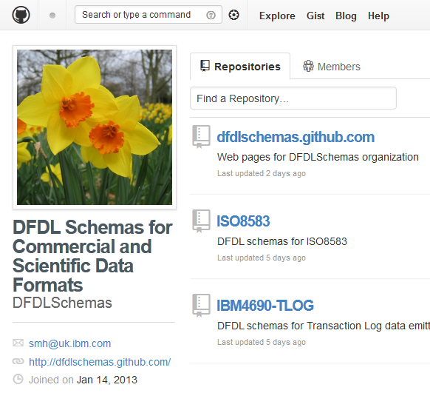
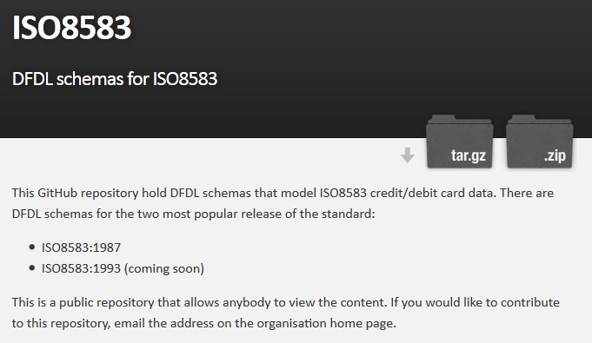
DFDL Schemas for Industry Formats
HL7 v2.5.1, v2.6 and v2.7
Connectivity Pack for Healthcare
IBM/Toshiba 4690 SurePos ACE v7r3 TLOG
DFDLSchemas on GitHub
ISO 8583 (1987)
DFDLSchemas on GitHub
IBM Integration Bus sample
More to follow…
Notes:
29

Slide 30
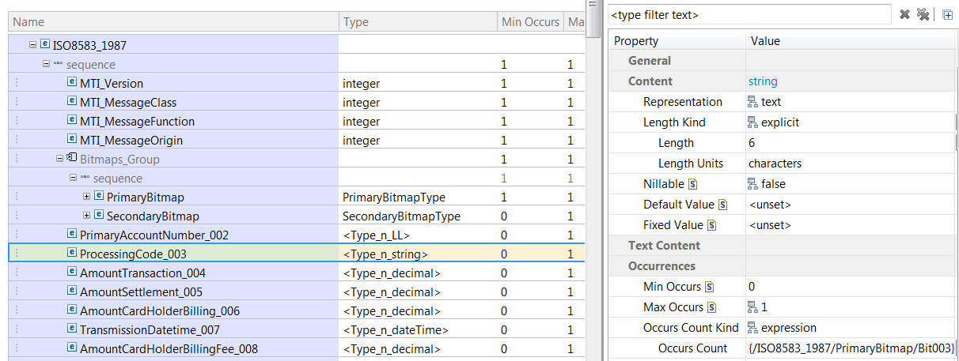
ISO 8583
ISO 8583 is a text/binary format used for ATM and credit card transactions
A message consists of a flat structure of simple data fields
Data fields are either fixed length or variable length with a prefix
lengthKind ‘explicit’ or lengthKind ‘prefixed’
Most data fields are optional (ie, minOccurs ‘0’) but there are no delimiters!
The presence of a field in the data is indicated by a flag in a special bitmap
occursCountKind ‘expression’, occursCount ‘{/ISO8583_1987/PrimaryBitmap/Bitxxx}’

Slide 31
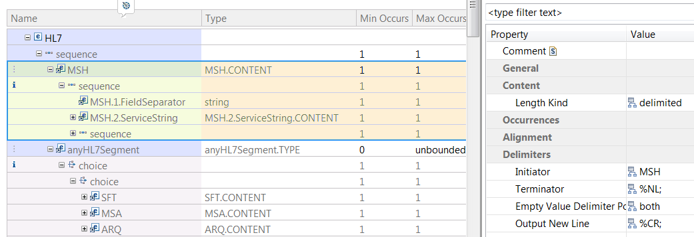

HL7 v2
HL7 v2 is a delimited text format used in the Healthcare industry
A message consists an MSH segment followed by a number of other segments
Each segment is identified by a 3 char tag and terminated by CR
Eg, initiator ‘MSH’, terminator ‘%NL;’, with a choice having initiatedContent ‘yes’
Segments contain variable length fields terminated by a delimiter, fields may be simple or complex, each level of nesting has its own delimiter (‘|’, ‘^’, ‘&’)
Fields may repeat and occurrences have their own delimiter (‘~’)
Delimiters are dynamically defined in the first (MSH) segment
separator ‘{/HL7/MSH/MSH.1.FieldSeparator}’

Slide 32
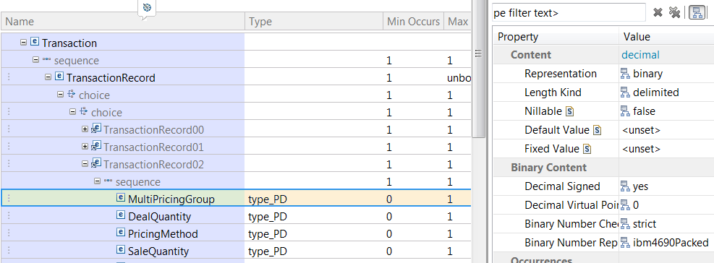
4690 TLOG
TLOG is a binary format created by IBM/Toshiba 4690 point-of-sale
A ‘transaction log’ consists of multiple different transaction records
Each transaction record has a type (and some records have a subtype)
Use a choice with a discriminator on each branch
Each transaction record is a sequence of delimited binary fields
lengthKind ‘delimited’
Most of the fields are a special packed decimal unique to 4690
representation ‘binary’, binaryNumberRep ‘ibm4690Packed’

Slide 33
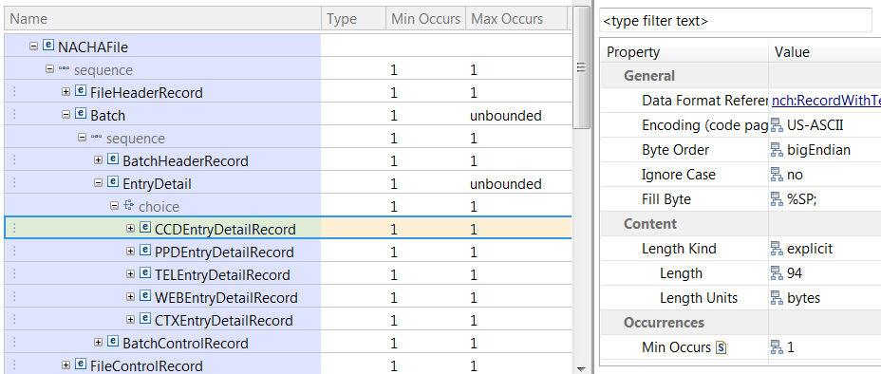
NACHA
NACHA is a text format used for electronic payments
A message consists of an envelope and repeating batches of records
There are different kinds of record but only one kind appears in a given batch
Use a choice with a discriminator on each branch
All records are 94 characters long and usually terminated with a new line
lengthKind ‘explicit’, length ‘94’, terminator ‘%NL;’
Each record is a sequence of fixed length fields

Slide 34
Agenda
DFDL in More Depth
Modeling Data using DFDL
Industry Format Examples
Questions

Slide 35
Legal Disclaimer
© IBM Corporation 2013. All Rights Reserved.
The information contained in this publication is provided for informational purposes only. While efforts were made to verify the completeness and accuracy of the information contained in this publication, it is provided AS IS without warranty of any kind, express or implied. In addition, this information is based on IBM’s current product plans and strategy, which are subject to change by IBM without notice. IBM shall not be responsible for any damages arising out of the use of, or otherwise related to, this publication or any other materials. Nothing contained in this publication is intended to, nor shall have the effect of, creating any warranties or representations from IBM or its suppliers or licensors, or altering the terms and conditions of the applicable license agreement governing the use of IBM software.
References in this presentation to IBM products, programs, or services do not imply that they will be available in all countries in which IBM operates. Product release dates and/or capabilities referenced in this presentation may change at any time at IBM’s sole discretion based on market opportunities or other factors, and are not intended to be a commitment to future product or feature availability in any way. Nothing contained in these materials is intended to, nor shall have the effect of, stating or implying that any activities undertaken by you will result in any specific sales, revenue growth or other results.
If the text contains performance statistics or references to benchmarks, insert the following language; otherwise delete: Performance is based on measurements and projections using standard IBM benchmarks in a controlled environment. The actual throughput or performance that any user will experience will vary depending upon many factors, including considerations such as the amount of multiprogramming in the user's job stream, the I/O configuration, the storage configuration, and the workload processed. Therefore, no assurance can be given that an individual user will achieve results similar to those stated here.
If the text includes any customer examples, please confirm we have prior written approval from such customer and insert the following language; otherwise delete: All customer examples described are presented as illustrations of how those customers have used IBM products and the results they may have achieved. Actual environmental costs and performance characteristics may vary by customer.
Please review text for proper trademark attribution of IBM products. At first use, each product name must be the full name and include appropriate trademark symbols (e.g., IBM Lotus® Sametime® Unyte™). Subsequent references can drop “IBM” but should include the proper branding (e.g., Lotus Sametime Gateway, or WebSphere Application Server). Please refer to http://www.ibm.com/legal/copytrade.shtml for guidance on which trademarks require the ® or ™ symbol. Do not use abbreviations for IBM product names in your presentation. All product names must be used as adjectives rather than nouns. Please list all of the trademarks that you use in your presentation as follows; delete any not included in your presentation. IBM, the IBM logo, Lotus, Lotus Notes, Notes, Domino, Quickr, Sametime, WebSphere, UC2, PartnerWorld and Lotusphere are trademarks of International Business Machines Corporation in the United States, other countries, or both. Unyte is a trademark of WebDialogs, Inc., in the United States, other countries, or both.
If you reference Adobe® in the text, please mark the first use and include the following; otherwise delete: Adobe, the Adobe logo, PostScript, and the PostScript logo are either registered trademarks or trademarks of Adobe Systems Incorporated in the United States, and/or other countries.
If you reference Java™ in the text, please mark the first use and include the following; otherwise delete: Java and all Java-based trademarks are trademarks of Sun Microsystems, Inc. in the United States, other countries, or both.
If you reference Microsoft® and/or Windows® in the text, please mark the first use and include the following, as applicable; otherwise delete: Microsoft and Windows are trademarks of Microsoft Corporation in the United States, other countries, or both.
If you reference Intel® and/or any of the following Intel products in the text, please mark the first use and include those that you use as follows; otherwise delete: Intel, Intel Centrino, Celeron, Intel Xeon, Intel SpeedStep, Itanium, and Pentium are trademarks or registered trademarks of Intel Corporation or its subsidiaries in the United States and other countries.
If you reference UNIX® in the text, please mark the first use and include the following; otherwise delete: UNIX is a registered trademark of The Open Group in the United States and other countries.
If you reference Linux® in your presentation, please mark the first use and include the following; otherwise delete: Linux is a registered trademark of Linus Torvalds in the United States, other countries, or both. Other company, product, or service names may be trademarks or service marks of others.
If the text/graphics include screenshots, no actual IBM employee names may be used (even your own), if your screenshots include fictitious company names (e.g., Renovations, Zeta Bank, Acme) please update and insert the following; otherwise delete: All references to [insert fictitious company name] refer to a fictitious company and are used for illustration purposes only.

